Slide 1
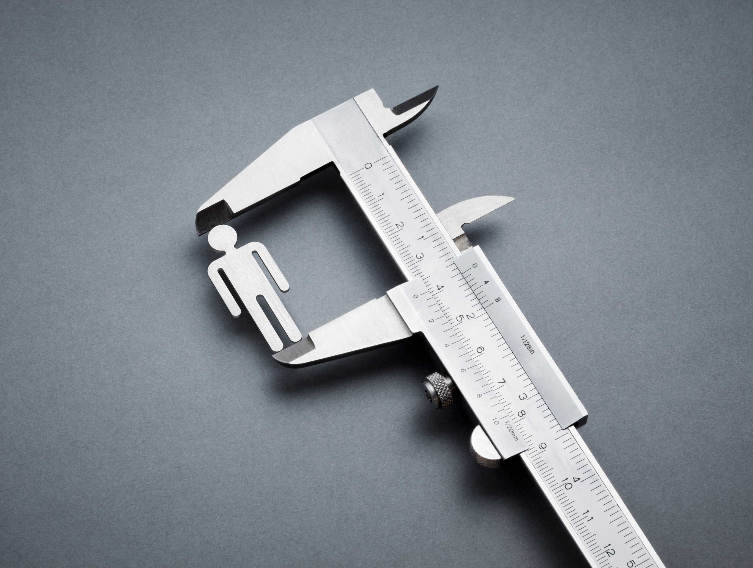

Feature Scaling
Why Do we need to perform
feature scaling ?

Slide 2
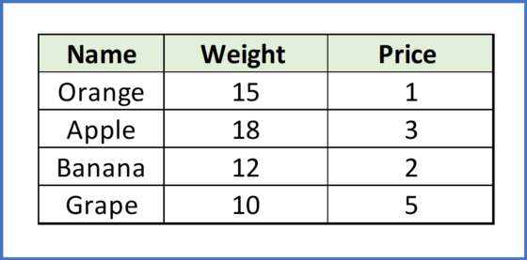
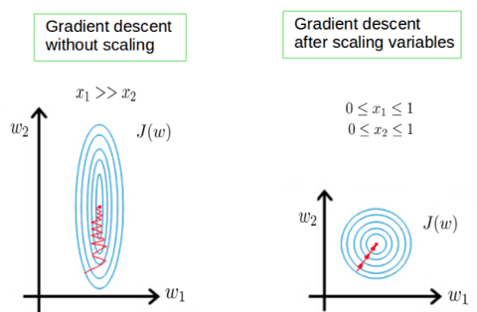
X1
X2
gradient descent converge
much faster with feature scaling
To find local minima

Slide 3
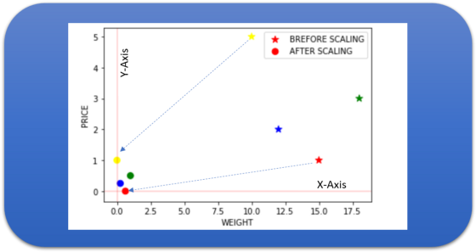
After Scaling

Slide 4
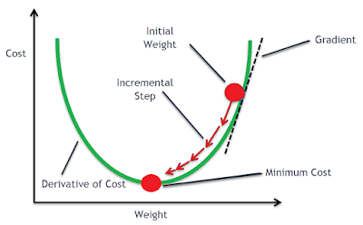







Slide 5
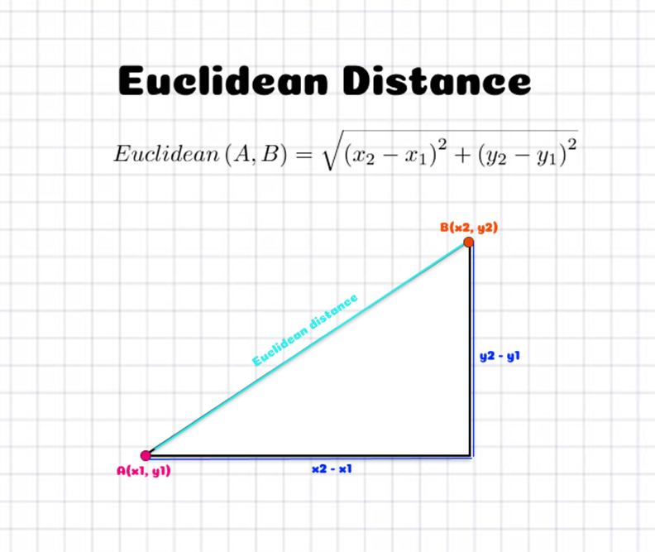
Euclidean Distance

Slide 6
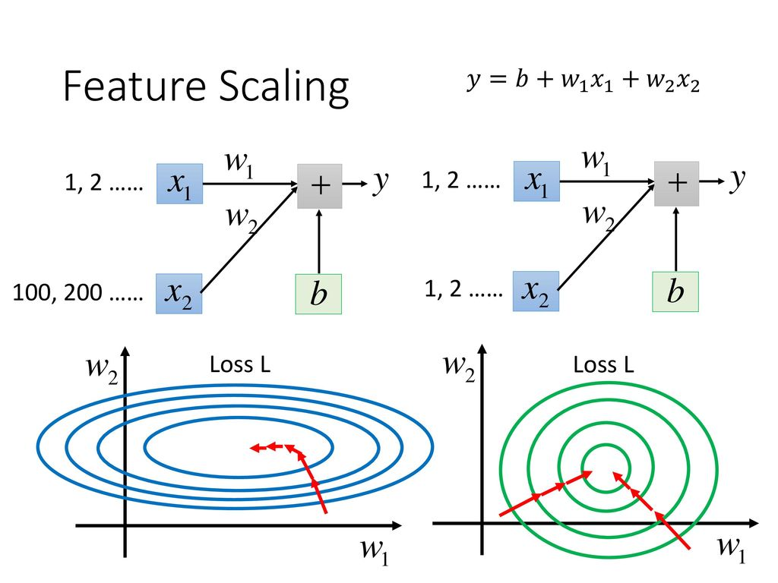

Slide 7
Your data in range 0 to 1
Before Scaling
After Scaling
Name | Weight | Price
Orange | 0.15 | 0.10
Apple | 0.18 | 0.30
Banana | 0.12 | 0.20
Grape | 0.10 | 0.50
Its make algorithm fast

Slide 8
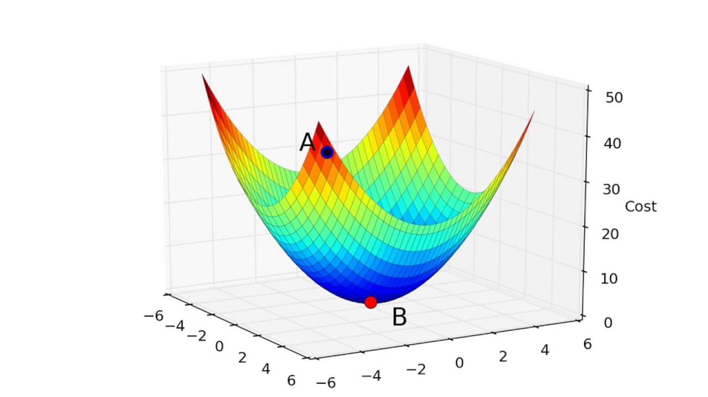

Slide 9

Some Machine Learning Algorithms
affected by Feature scaling are
Linear and Logistic Regression
Neural Networks
Support Vector Machines
KNN
K-mean clustering
PCA

Slide 10
Feature scaling Techniques
Standardisation
Mean Normalization
MinMax Scaling
MaxAbs Scaling
Robust Scaling
Normalization to vector unit scale

Slide 11
Make Algorithms Fast
Last Step of data processing

Slide 12
Thanks for Watching

Slide 13
Standardization

Slide 14

from sklearn.preprocessing import StandardScalar
What exactly is standardize??

Slide 15

Before learning Standardization you also need to know about Normalization

Slide 16
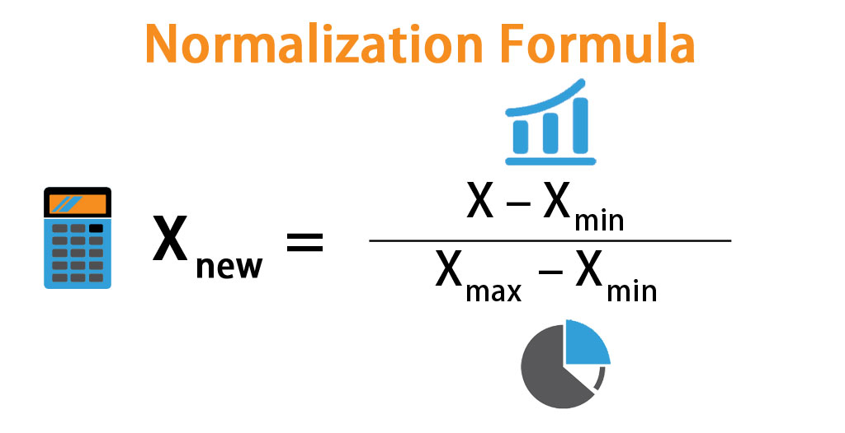
Normalization:
In column normalization we tool column values and compressed it in range between [0, 1]

Slide 17
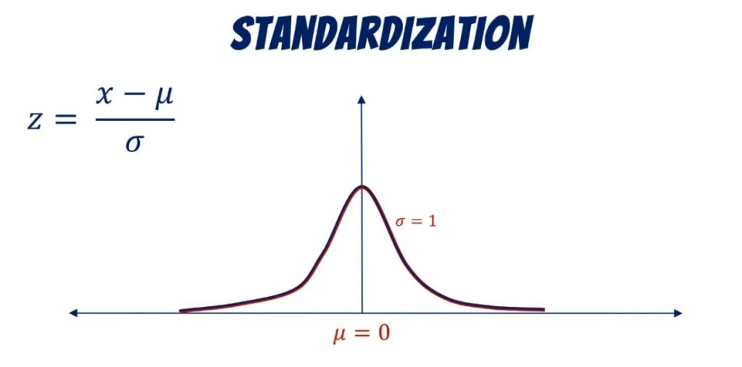
Standardization
In column standardization we tool column values and compressed it around 0.

Slide 18
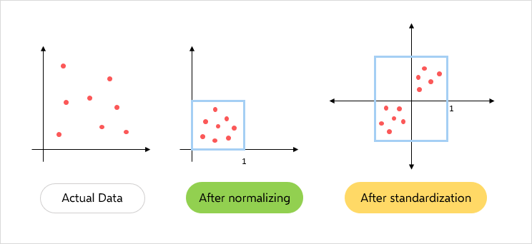
First Quadrant

Slide 19
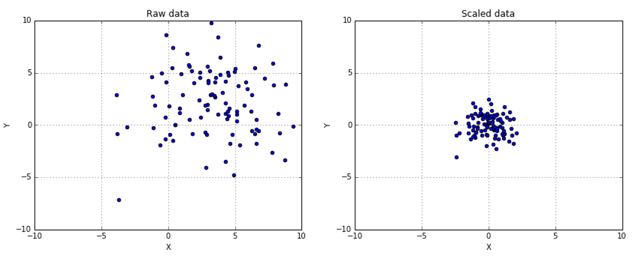
Standardization

Slide 20
If we don’t do standardization does it affect anything?

